Slide 1
Introduction to grep

Slide 2


Slide 3
Grep
Where do I find grep?

Slide 4
Kali linux
Grep was originally developed for the Unix operating system, but later available for all Unix-like systems.
You can install Kali Linux as the primary boot, dual boot, or on a virtual machine. Personally, I use Virtualbox to run Kali Linux.
Once Kali Linux is installed, you can access grep through the terminal window.

Slide 5
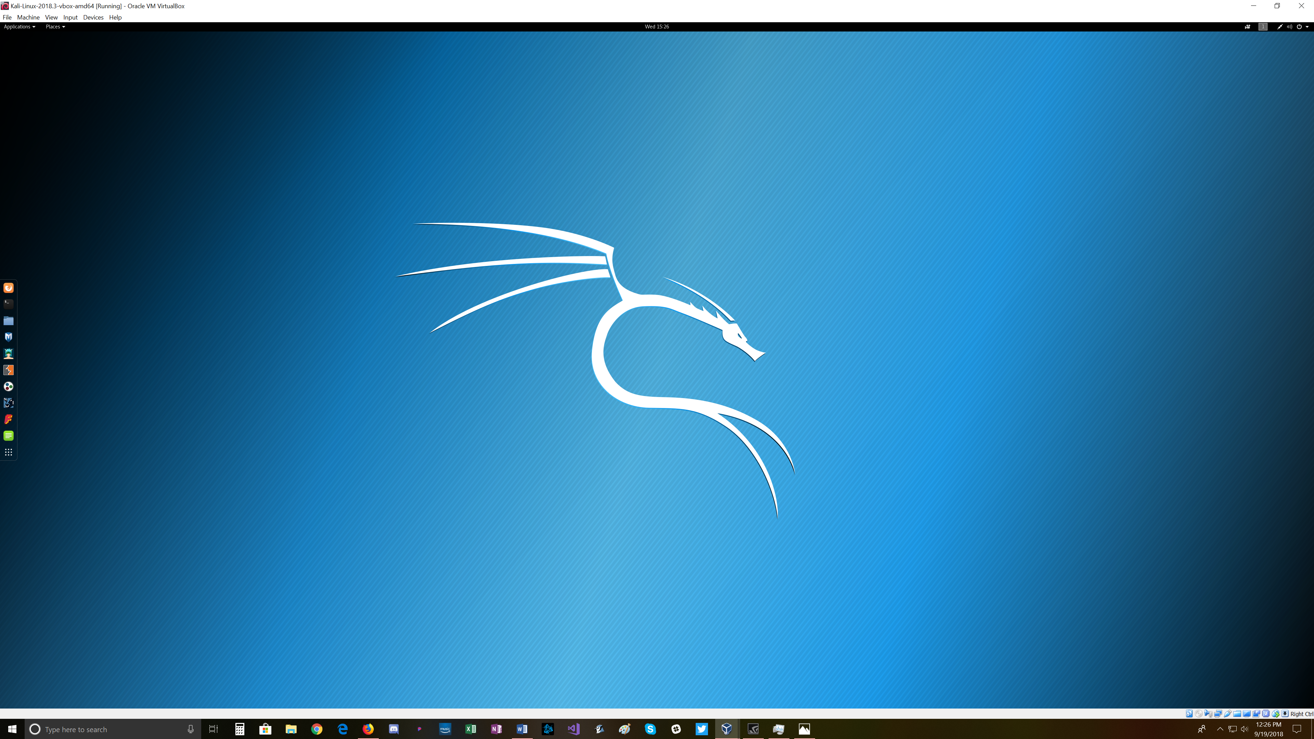

Slide 6
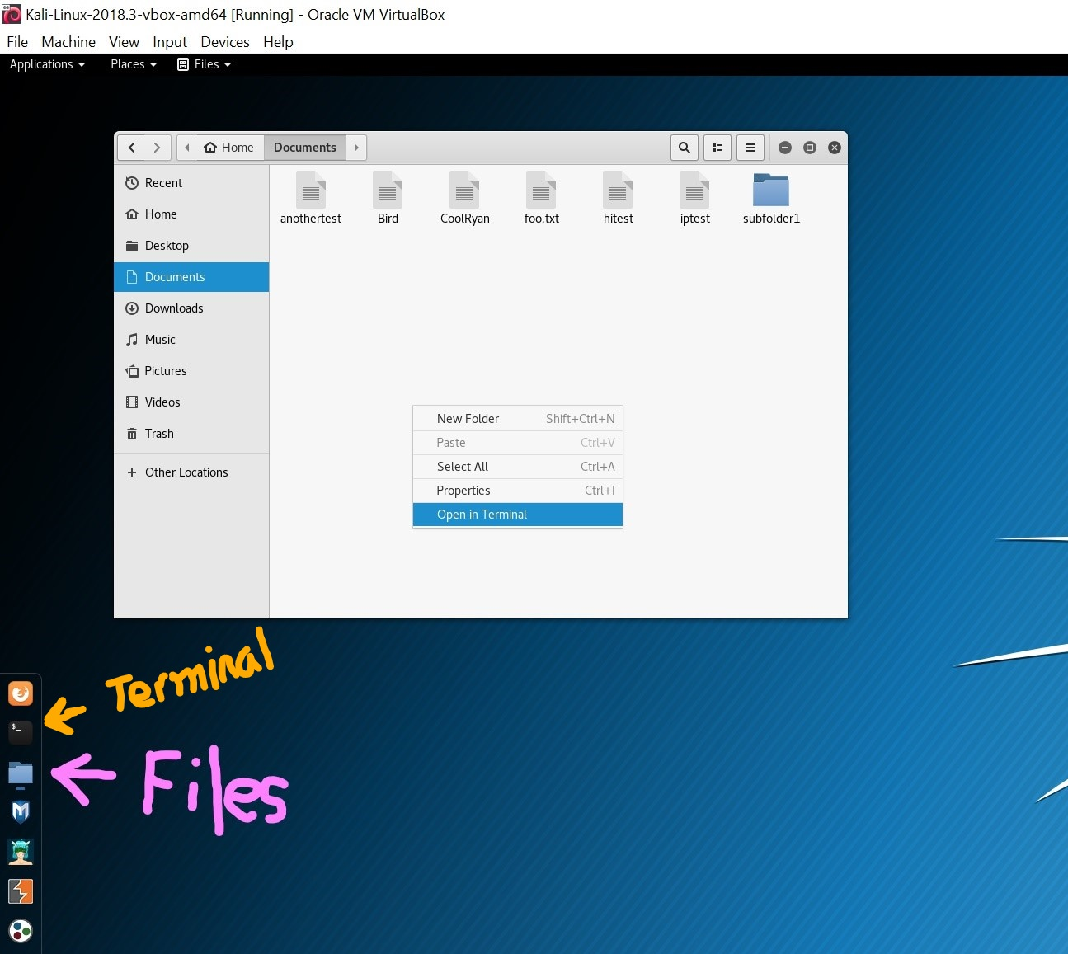
You can right click and access the terminal here.

Slide 7
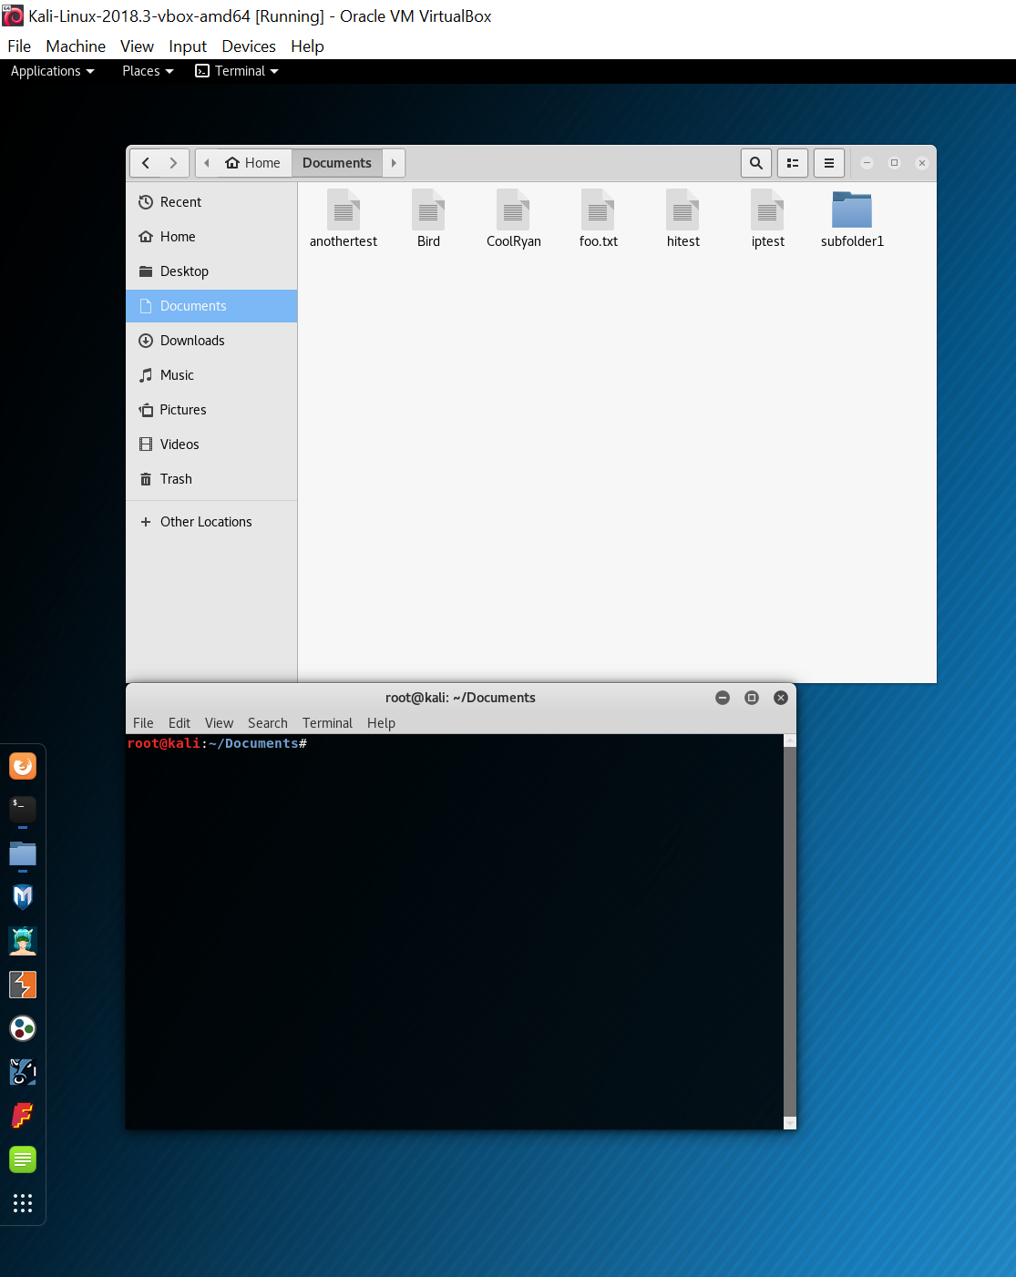

Slide 8
Grep
What is grep?

Slide 9
grep is a command-line utility for searching plain-text data sets for lines that match a regular expression. Its name comes from the ed command g/re/p (globally search a regular expression and print), which has the same effect: doing a global search with the regular expression and printing all matching lines.

Slide 10
Grep commands
Common grep commands
grep [options] [regexp] [filename]
grep -i (case-insensitive search)
grep -c (count)
grep -w (whole-word search)
grep -v (inverted search)
grep --help (brings up help menu)

Slide 11
Grep Intro video
https://youtu.be/oeydWnRLj14

